Slide 1
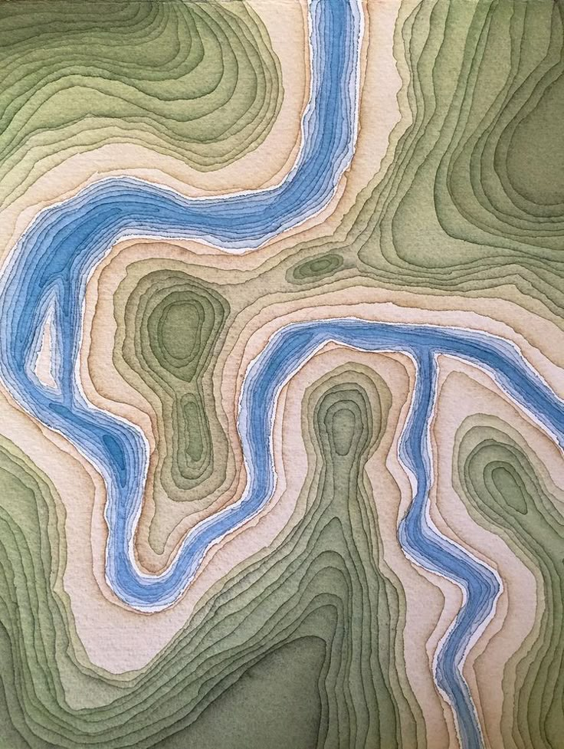





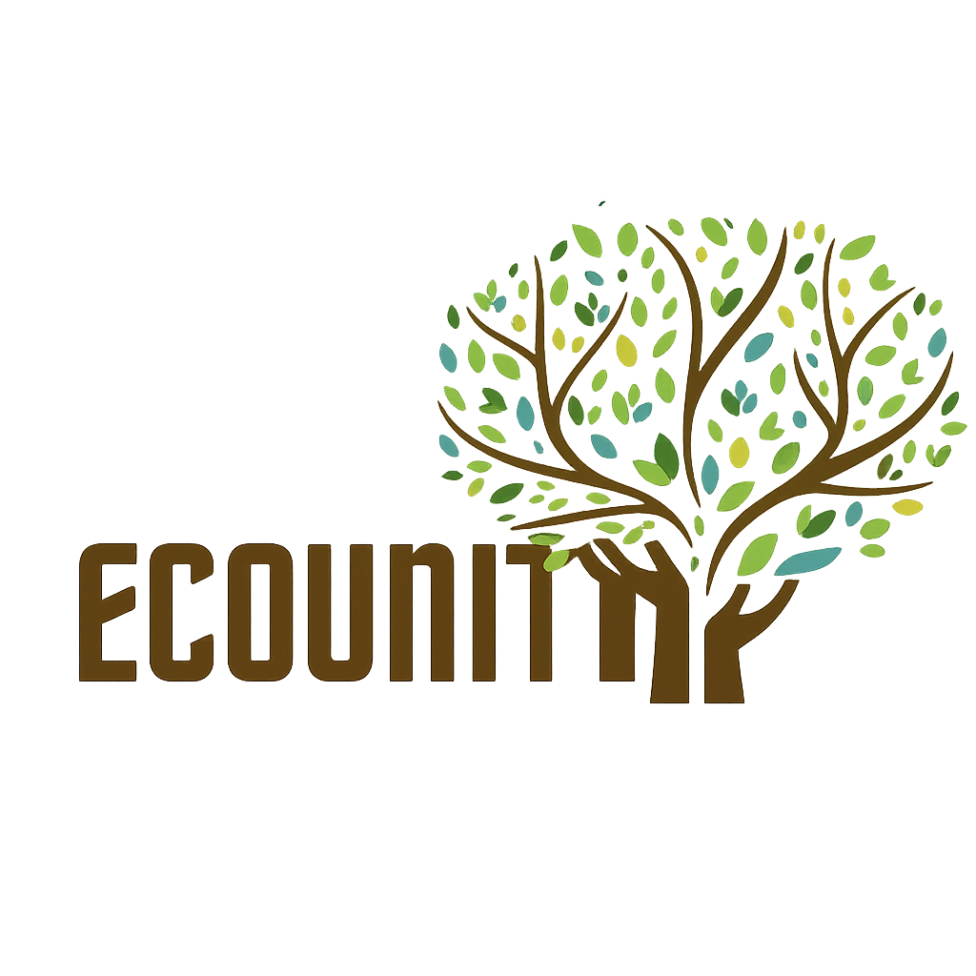
“Recovery begins with unity”
Ukrainian State University of Railway Transport
Sumy National Agrarian University
Use of satellite technologies and geographic information systems in the restoration of natural resources in the Kharkiv region.
Solutions for environmental safety and sustainable development

Slide 2
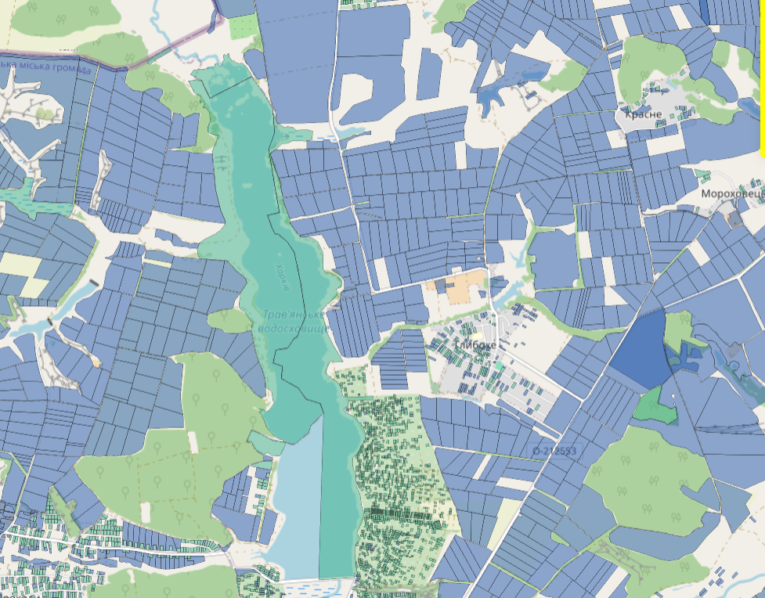
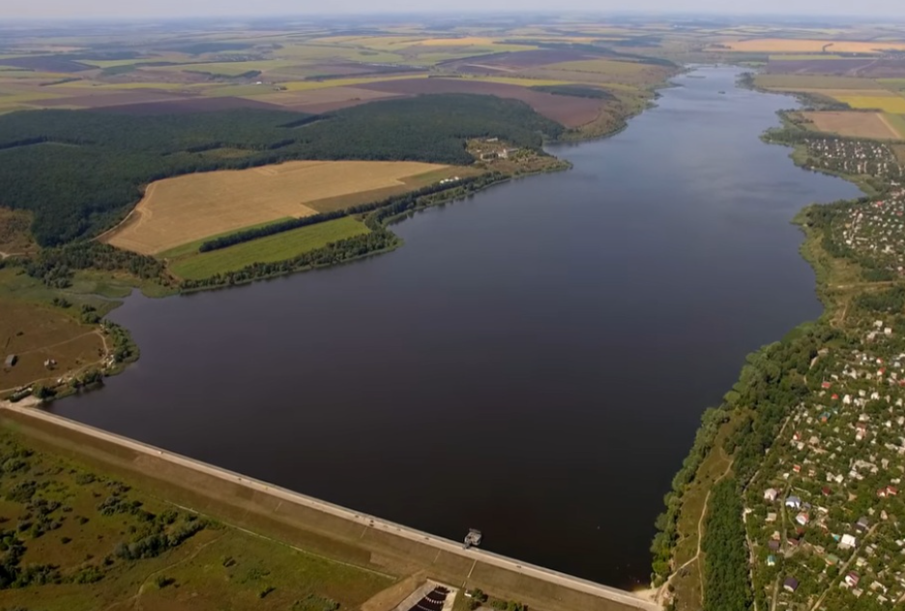
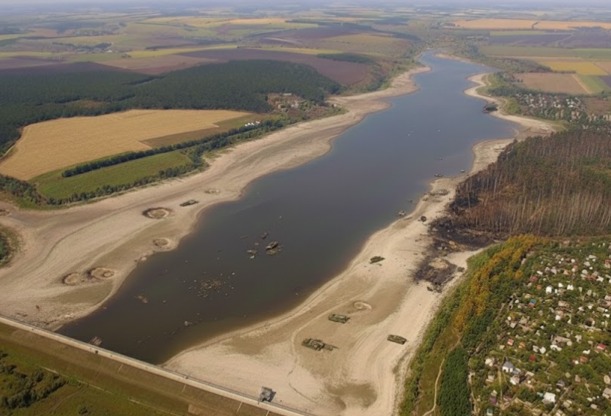
Ecosystem degradation due to war
Before
After
Travian Reservoir: critical drop in water level.
Landmines and soil contamination.
Loss of access to clean water for the Lipetsk community.

Slide 3
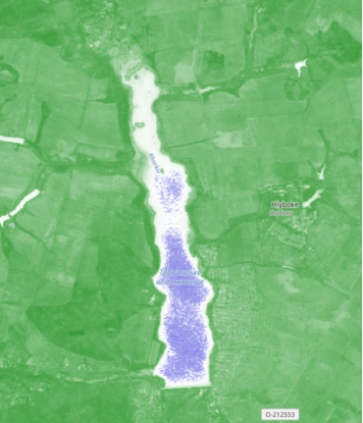
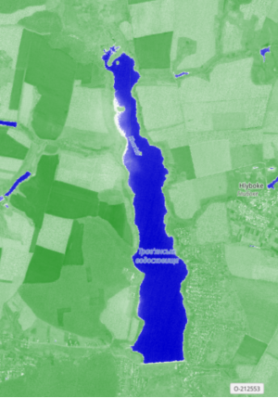

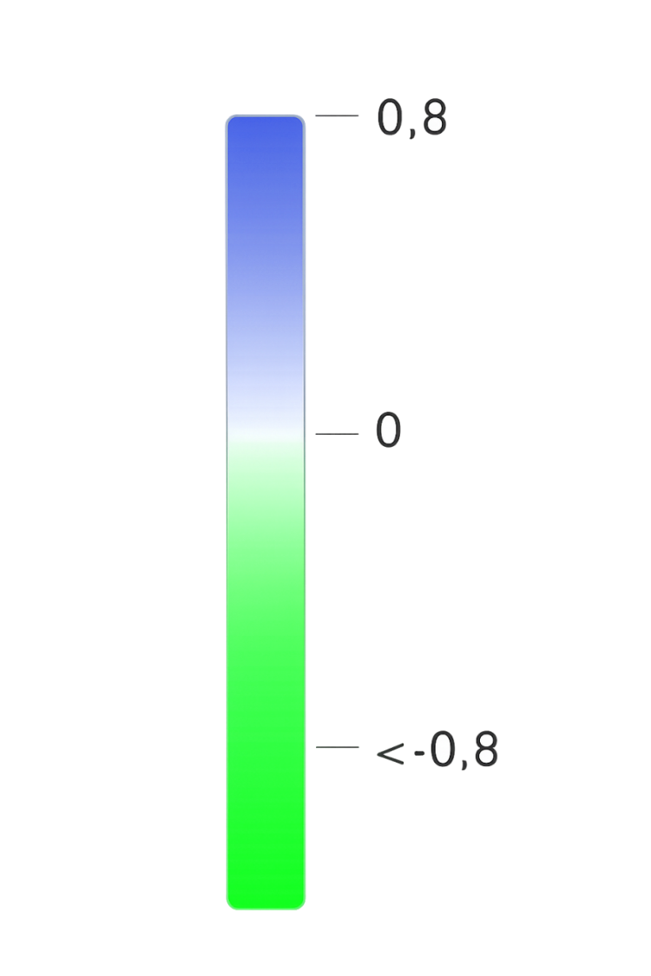

Normalized Difference Water Index (NDWI)
EcoUnity: Innovative monitoring and educational GIS platform for natural resource restoration. We provide 90% accuracy in water body analysis, creating a safe path from environmental disaster to sustainable community development.
November 2021
118 hectares of water area
require immediate restoration
The normalized difference water index is most suitable for mapping water bodies. Values for water bodies exceed 0.5. Vegetation has lower values. Built-up areas have positive values ranging from zero to 0.2.
May 2025

Slide 4
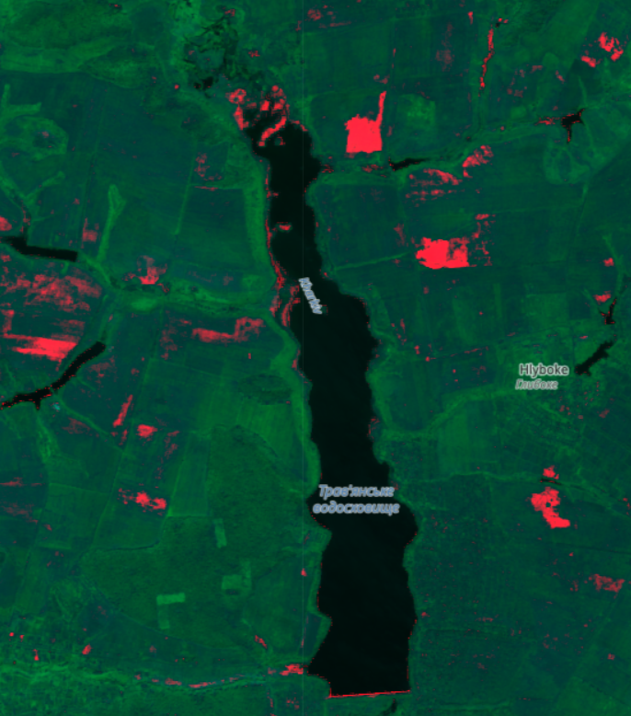


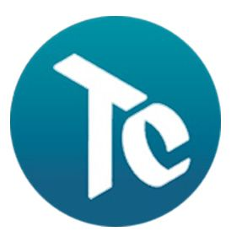
GIS platform for monitoring and reclamation
Analysis of Sentinel-1 and Sentinel-2 satellite data.
Automatic calculation of indices (NDWI, NDVI).
Recommendation map for the community.
Software:
QGIS — creation of NDWI and NDVI index maps, analysis of changes in water regime and vegetation cover between 2021 and 2025.
TopoCAD — construction of a digital elevation model (DEM) and analysis of slopes to identify areas of potential erosion.
Our platform includes an educational module for students to learn GIS and ecology in real-time

Slide 5
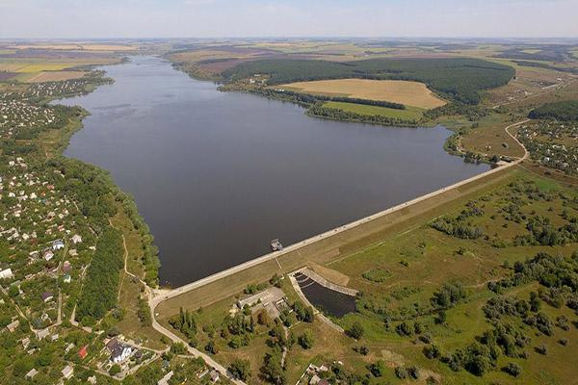
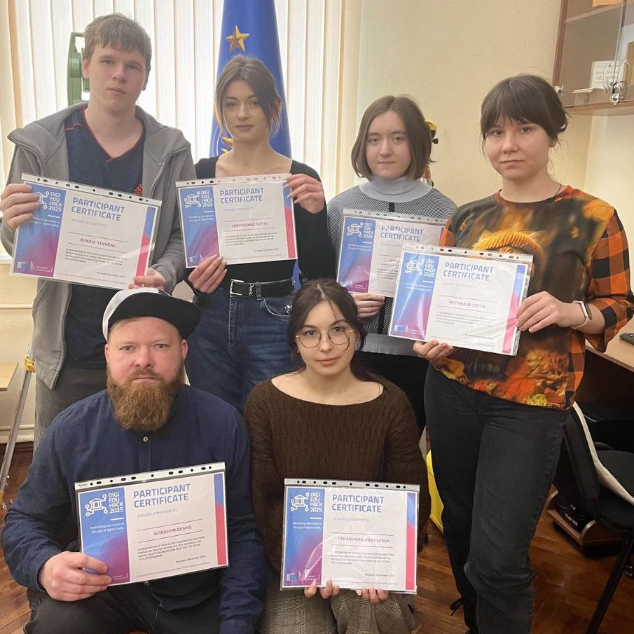


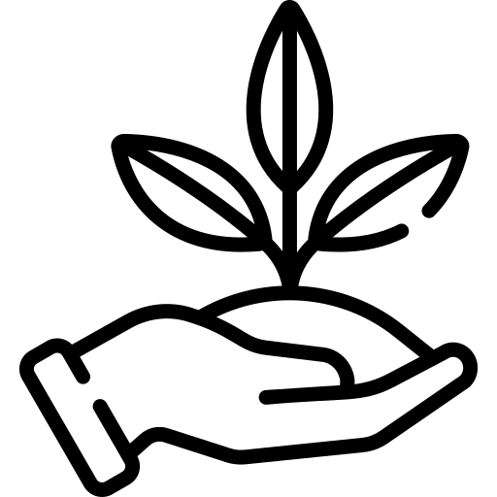

Comprehensive Recovery Program: Three Pillars of Reclamation
30+ new jobs
15% increase in crop yields
Short-term measures (1–3 years):
Cleaning up debris and silt, repairing the dam. Clearing tributary channels, restoring water exchange. Creating coastal protection strips, stocking the reservoir with fish.
Long-term measures (3–10 years):
Ecosystem restoration: planting moisture-loving plants, buffer zones. Modernization of hydraulic structures. Regular monitoring of water quality and ecosystem status.
Social aspect:
Involvement of the community in eco-actions and care for the reservoir. Information campaign on the importance of cleanliness and sustainable use.
Our goal is to expand to the Sumy and Mykolaiv regions.
Vote for EcoUnity – Vote for Ukraine’s Green Recovery!
The EcoUnity project proves that modern technologies are not only a tool for analysis, but also a path to the revival of nature, the development of communities, and the formation of a sustainable future for Ukraine.

Slide 6
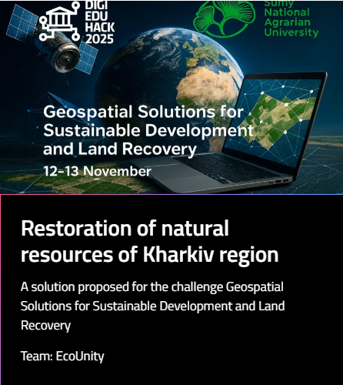
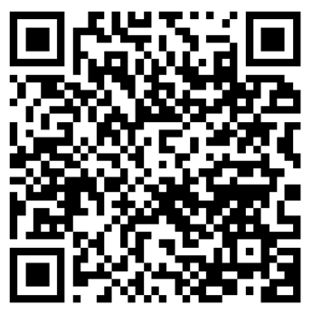
Our goal is to expand to the Sumy and Mykolaiv regions. Support EcoUnity with your vote! Thank you for your attention!

