Slide 1
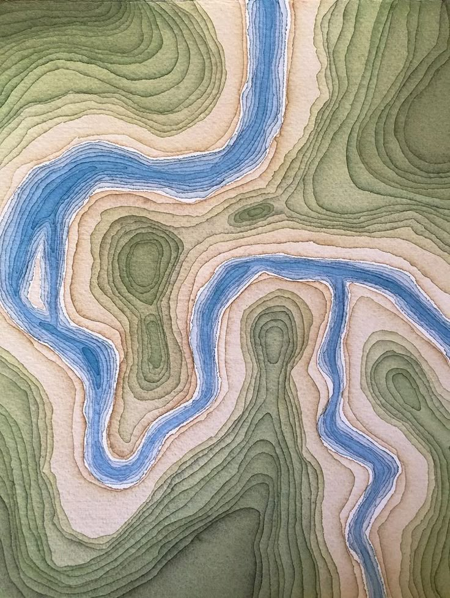





Use of satellite technologies and geographic information systems in the restoration of natural resources in the Kharkiv region.
Solutions for environmental safety and sustainable development
DigiEduHack 2025

Slide 2
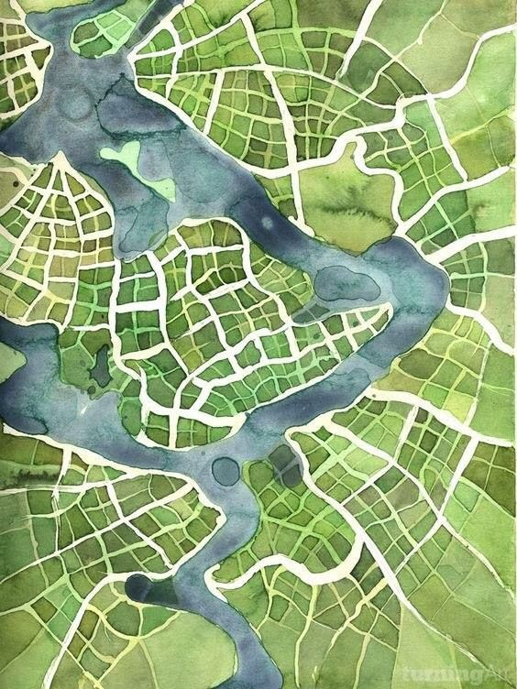


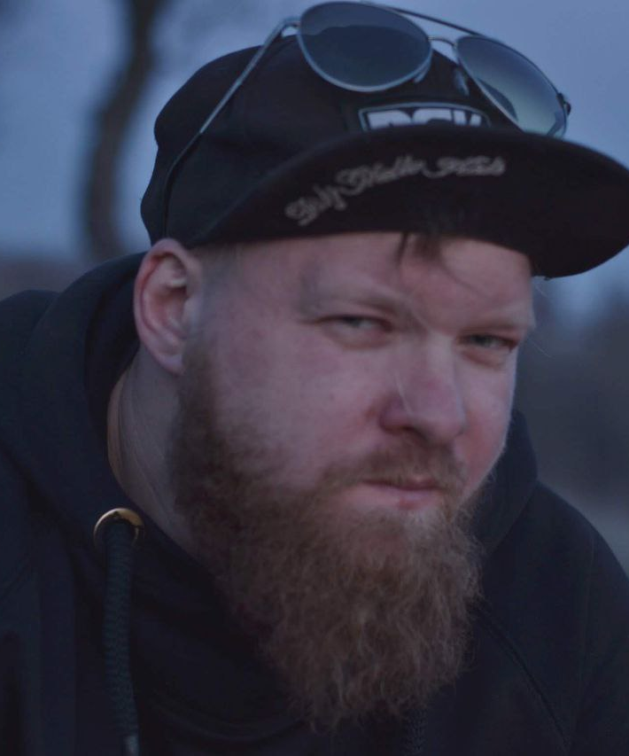

Our team
Daria Lopareva,
1st year bachelor's student,
group 103-GZ-D25.
Denys Konshyn, 4th year,
group 103-GZ-D22
Anastasiia Taranukha, 1st year of master's degree,
group 216-GZ-D25.

Slide 3

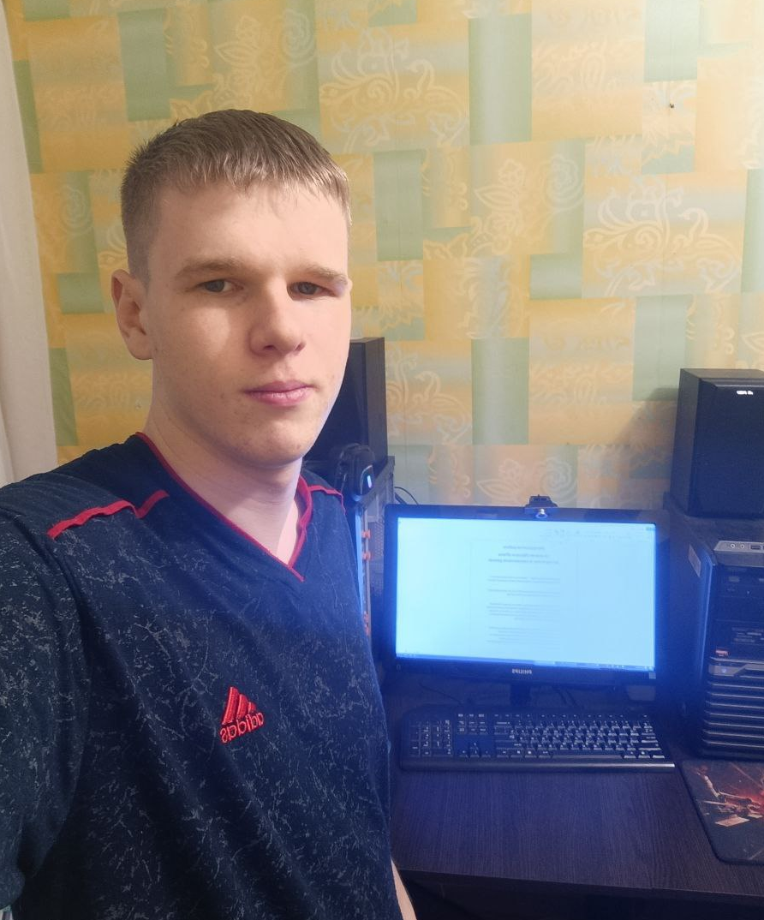
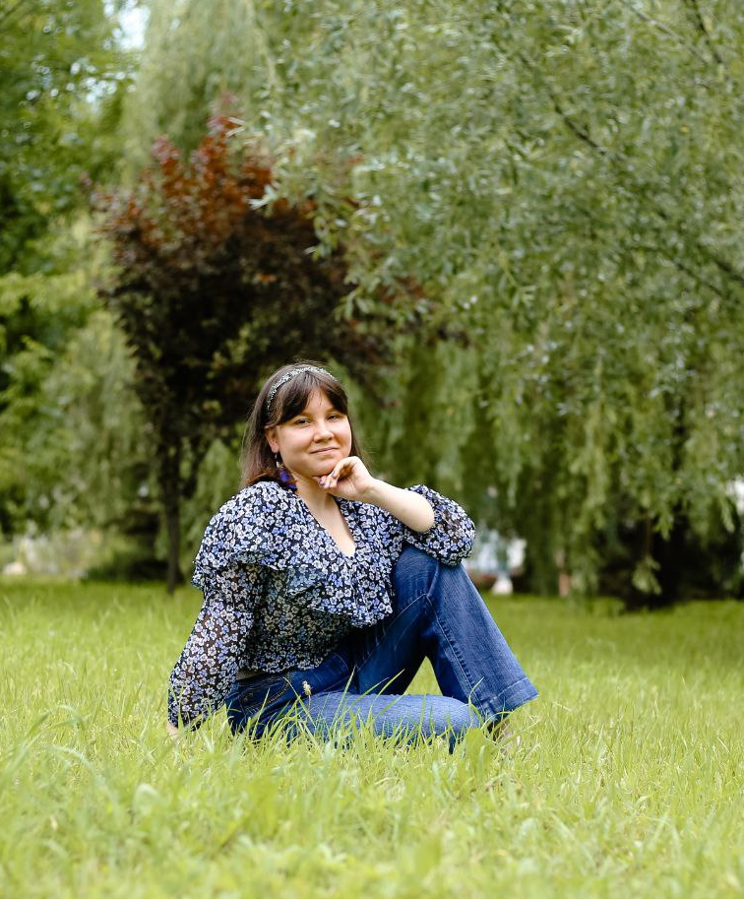
“Recovery begins with unity”
Вступ
Yevgeniy Rinda, 1st year bachelor's student,
group 103-GZ-D25
Sofia Shevchenko, 4th year,
group 103-GZ-D22
Sofia Nechaeva, 3rd year,
group 103-GZ-D23

Slide 4
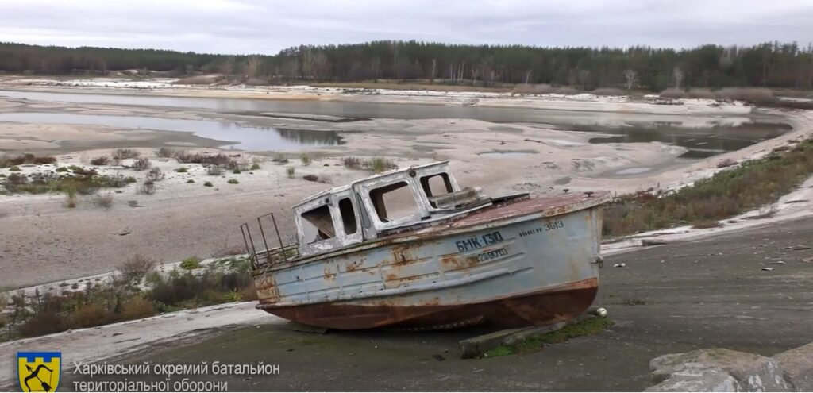
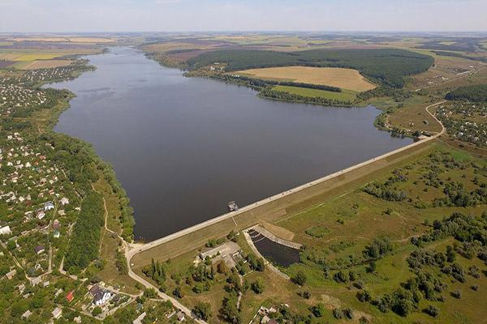
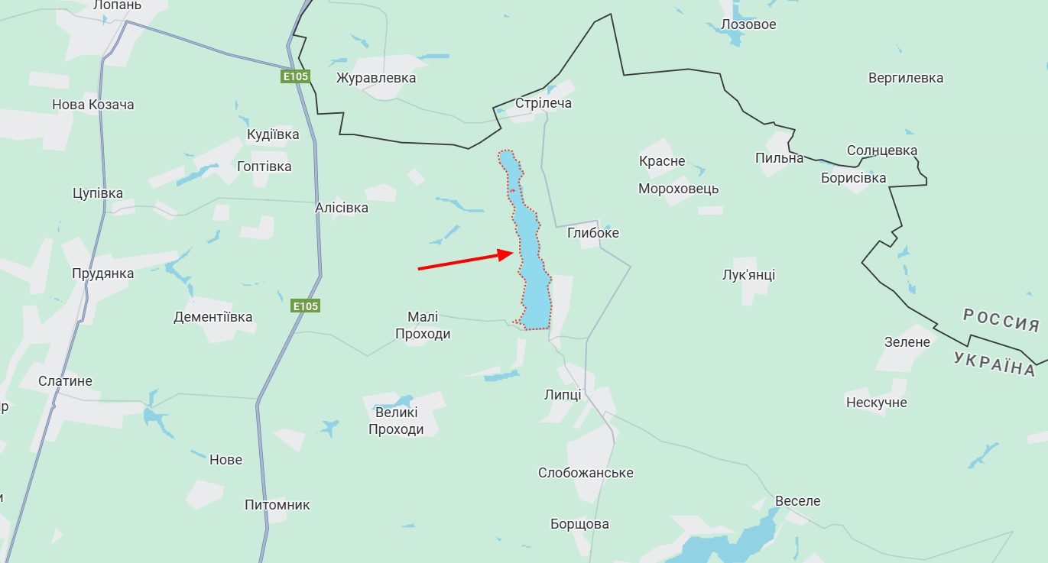
Методологія роботи
Introduction
Subject of research: natural resources (water, land) of the Kharkiv region affected by hostilities.
Research objective:
to assess the ecological condition of the Travyansky Reservoir within the Lipetsk United Territorial Community;
to develop a map of recommendations and implement practical solutions for the restoration of the Kharkiv region.
Research objectives:
Determine the extent of water body degradation using Sentinel-1 and Sentinel-2 satellite data.
Analyze changes in the water surface and vegetation cover (NDWI, NDVI).
Identify the most damaged areas and develop a plan for priority environmental interventions.
Prepare a map of recommendations and a prototype GIS solution for further reclamation.

Slide 5
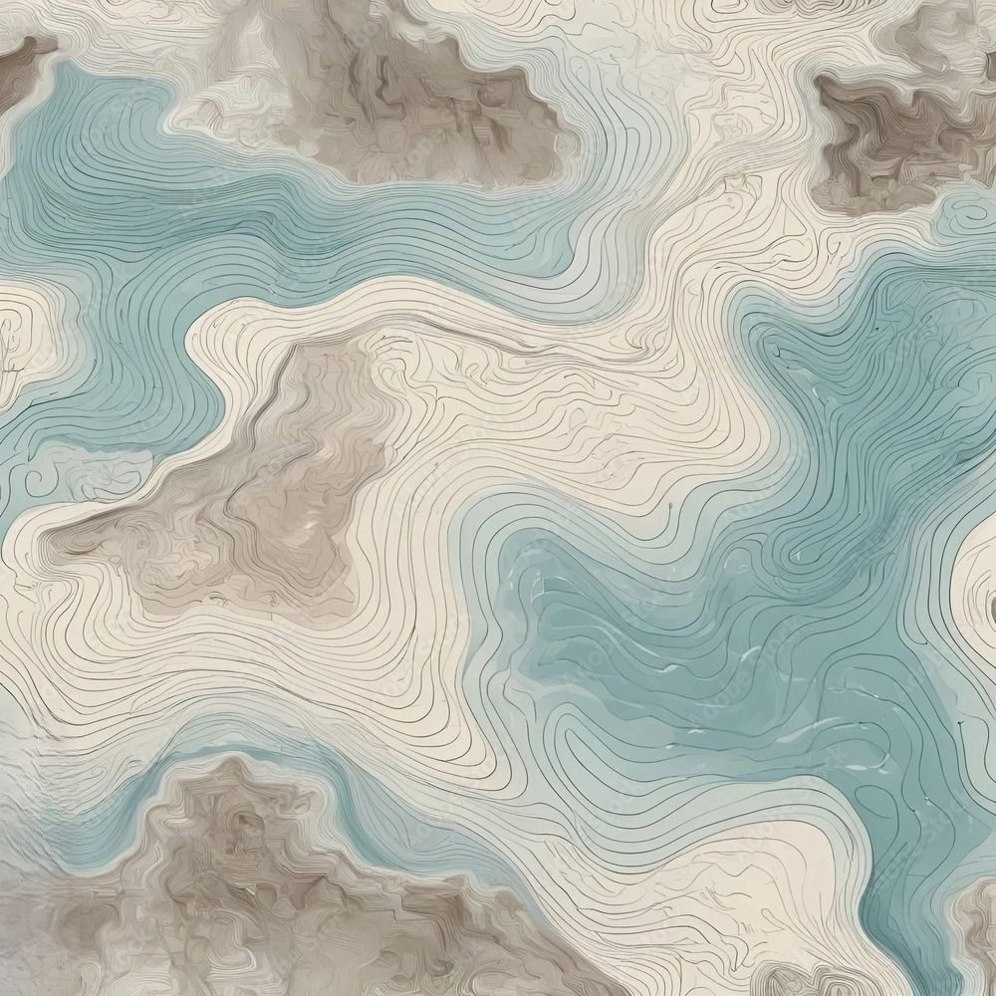
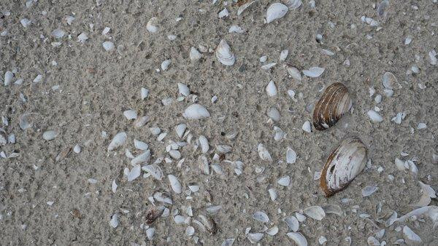
Work methodology
Використані дані для дослідження
Description of the Travian Reservoir and use of data
Definition, geographical location, main parameters and characteristics
Purpose of creating this reservoir
Fresh water reserve complex for the city of Kharkiv
The main reason for the decrease in water level in the Travian Reservoir
The Travianske and Tymofiivske reservoirs in the Kharkiv region have been almost destroyed due to military operations.
Location of the Travyansky Reservoir

Slide 6
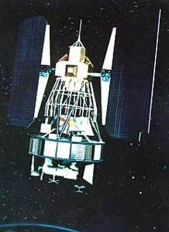
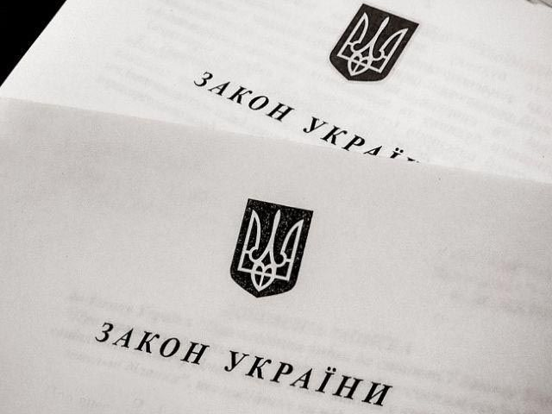
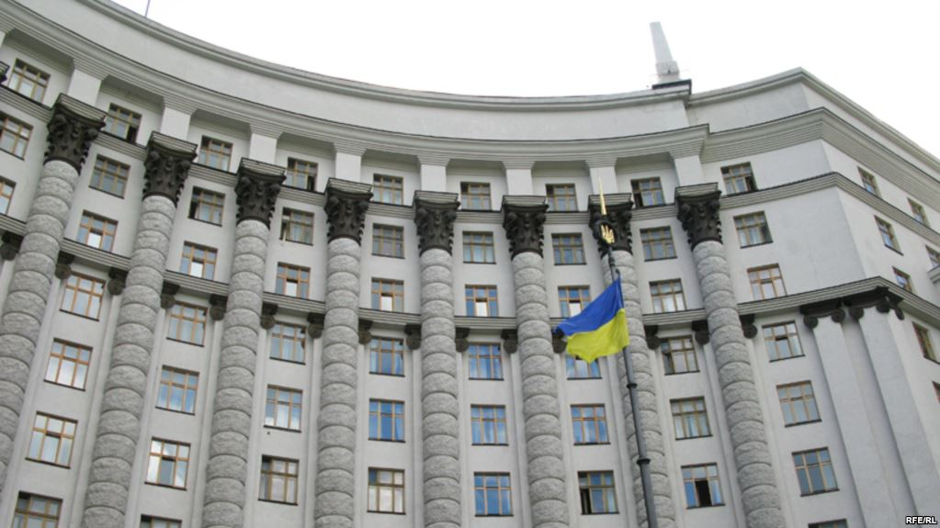
Data used for the study
Нормативно-правове забезпечення
The following data are used for the study:
Satellite remote sensing images
Cartographic materials
Ground-based research
Ground-based hydrophysical, hydrochemical, and hydrobiological indicators
Водний кодекс України — регулює використання, охорону та експлуатацію водних ресурсів і водосховищ.
Закон “Про охорону навколишнього природного середовища” — визначає принципи охорони довкілля та відповідальність за його порушення.
Постанова КМУ №758 — встановлює порядок державного моніторингу водних ресурсів.
Національна стратегія відновлення України — задає напрям післявоєнного відновлення природних екосистем.
Рекомендації OECD та EU4Environment — визначають екологічні стандарти відбудови водного сектору.
Landsat-1

Slide 7
Regulatory and legal support
Використання кадастрових даних
The Water Code of Ukraine regulates the use, protection, and exploitation of water resources and reservoirs.
The Law “On Environmental Protection” defines the principles of environmental protection and liability for violations.
CMU Resolution No. 758 establishes the procedure for state monitoring of water resources.
The National Strategy for the Restoration of Ukraine sets the direction for the post-war restoration of natural ecosystems.
The OECD and EU4Environment recommendations define environmental standards for the restoration of the water sector.

Slide 8
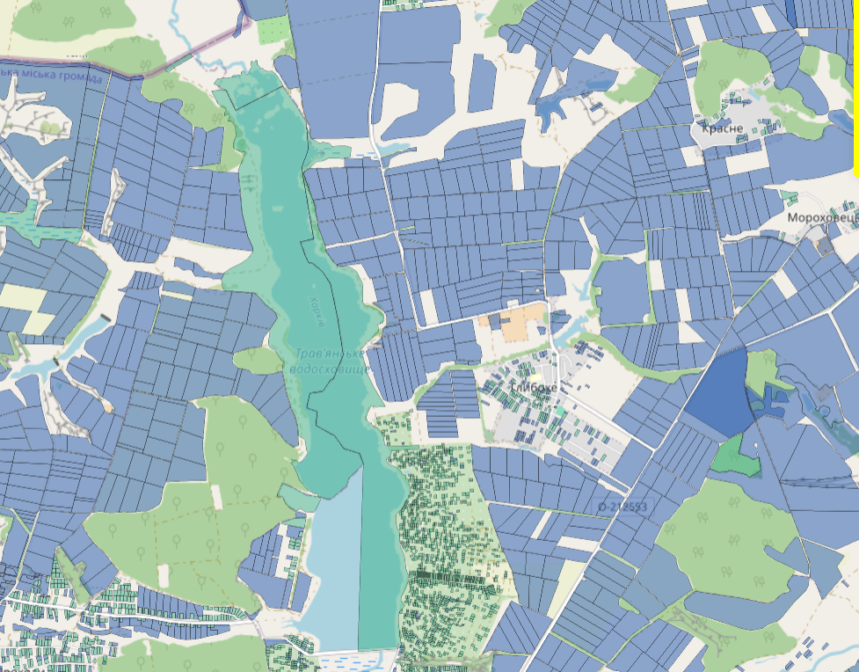
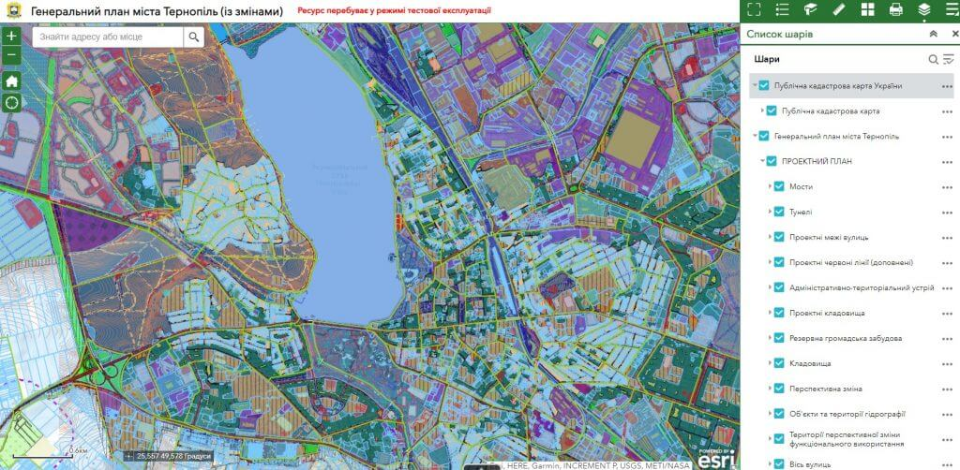
Use of cadastral data
Геоінформаційний аналіз
Ensures the accuracy of boundaries and land status.
Integration with GIS showed the structure of land use.
Changes were identified based on satellite observations.
Allows you to determine the status of plots and responsible land users.

Slide 9
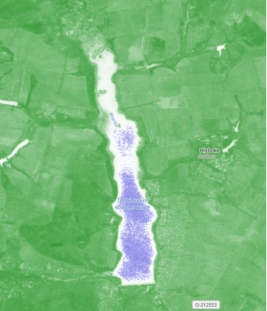
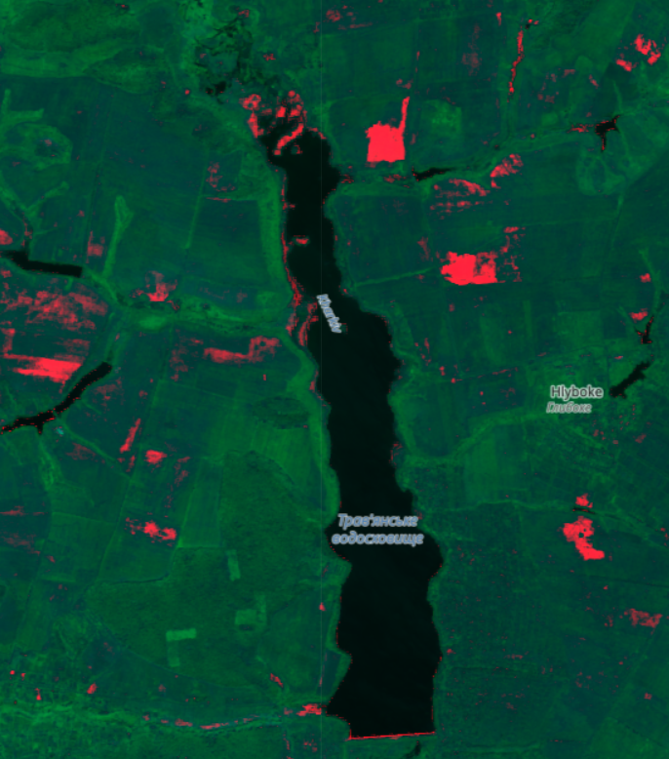
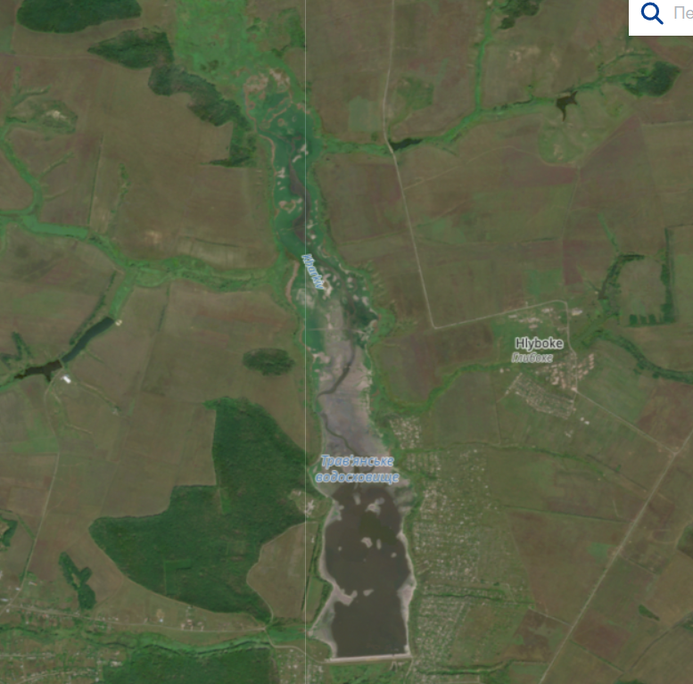


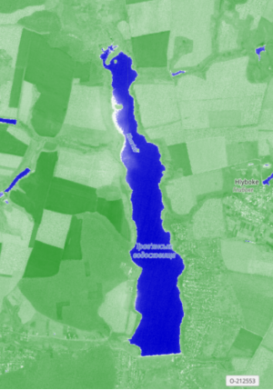
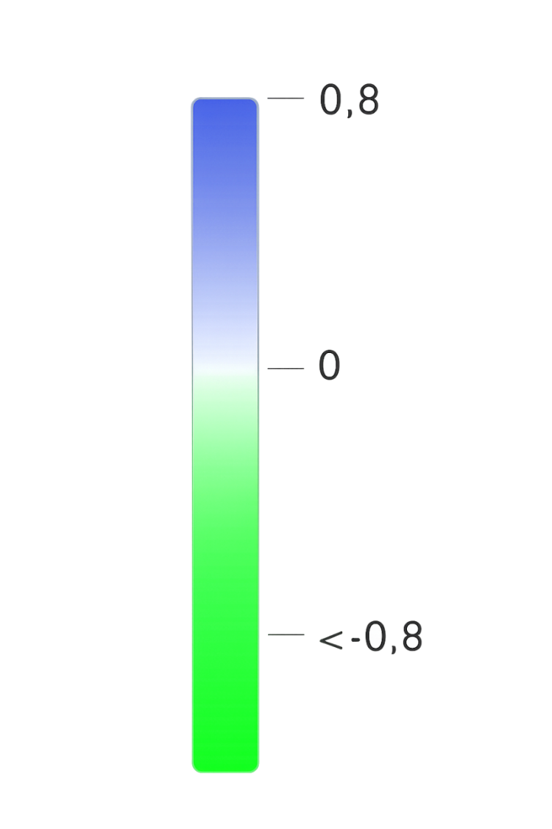
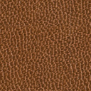
Geographic information analysis
Листопад 2025 року
Нормалізований різницевий індекс води NDWI
Materials and analysis tools used
Satellite data:
Sentinel-1 — radar images for assessing surface moisture and soil structure.
Sentinel-2 — optical images for determining water surface area and vegetation condition.
Software:
QGIS — creation of NDWI and NDVI index maps, analysis of changes in water regime and vegetation cover between 2021 and 2025.
TopoCAD — construction of a digital elevation model (DEM) and analysis of slopes to identify areas of potential erosion.
Травень 2021 року

Slide 10
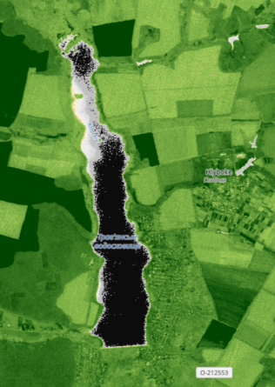

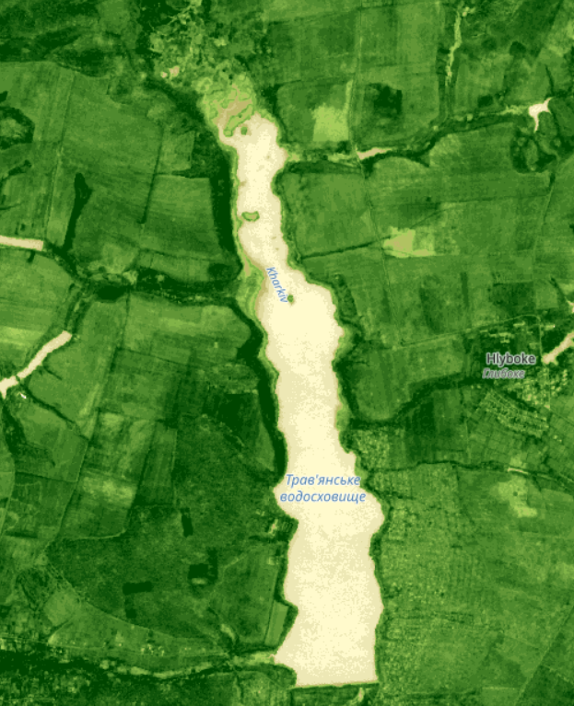

Normalized Difference Water Index (NDWI)
Травень 2021 року
Нормалізований індекс різниці рослинності NDVI
The normalized difference water index is most suitable for mapping water bodies. Values for water bodies exceed 0.5. Vegetation has lower values. Built-up areas have positive values ranging from zero to 0.2.
November 2021
May 2025
Листопад 2025 року

Slide 11
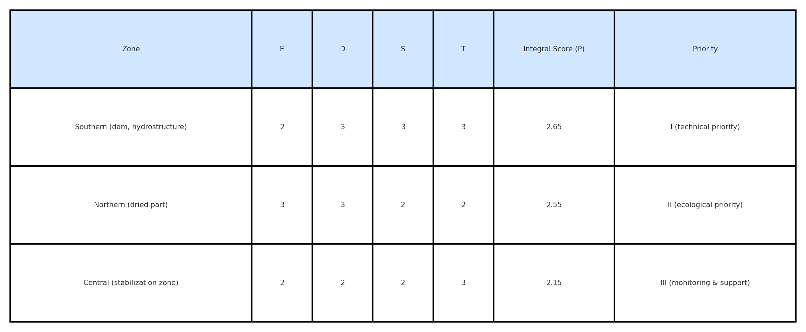
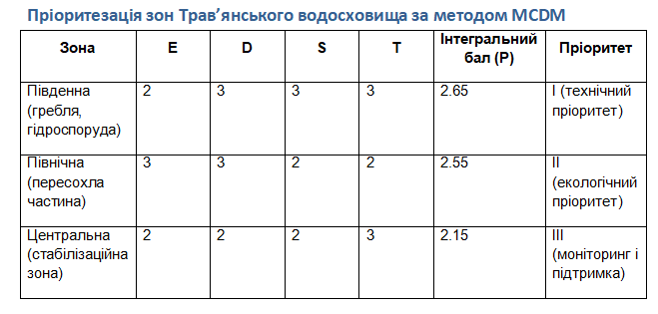
Normalized Difference Vegetation Index (NDVI)
Пріоритетні зони для інтервенцій — ранжовані за методом MCDM
May 2025
The Normalized Difference Vegetation Index (NDVI) is an indicator of green vegetation cover determined by light reflection in different spectral ranges. NDVI values range from -1 to 1:
< 0 — water or unproductive surfaces;
0–0.2 — low vegetation or lifeless surfaces;
0.2–0.4 — shrubs and meadows;
> 0.4 — dense forests and healthy vegetation.
The closer the NDVI is to 1, the healthier and denser the vegetation.
November 2021

Slide 12



Priority areas for intervention — ranked using the MCDM method
Листопад 2025 року
Довгострокові заходи (3–10 років):
Екосистемне відновлення: насадження вологолюбних рослин, буферні зони.
Модернізація гідротехнічних споруд.
Регулярний моніторинг якості води й стану екосистеми.
Комплексна Програма Відновлення: Три Стовпи Рекультивації
MCDM criteria
E — Ecological value: assessment of biodiversity and vegetation condition (NDVI).
D — Degree of damage: changes in water surface and ecosystem degradation (NDWI, NDVI).
S — Social significance: impact on the community, proximity to settlements and farmland.
T — Technical feasibility: terrain, road network, possibility of performing work (DEM).
Короткострокові заходи (1–3 роки):
Очищення від сміття й мулу, ремонт дамби.
Розчищення русел приток, відновлення водообміну.
Створення прибережних захисних смуг, зариблення водойми.
Соціальний аспект:
Залучення громади до екоакцій і догляду за водоймою.
Інформаційна кампанія про важливість чистоти та сталого використання.
Травень 2021 року

Slide 13
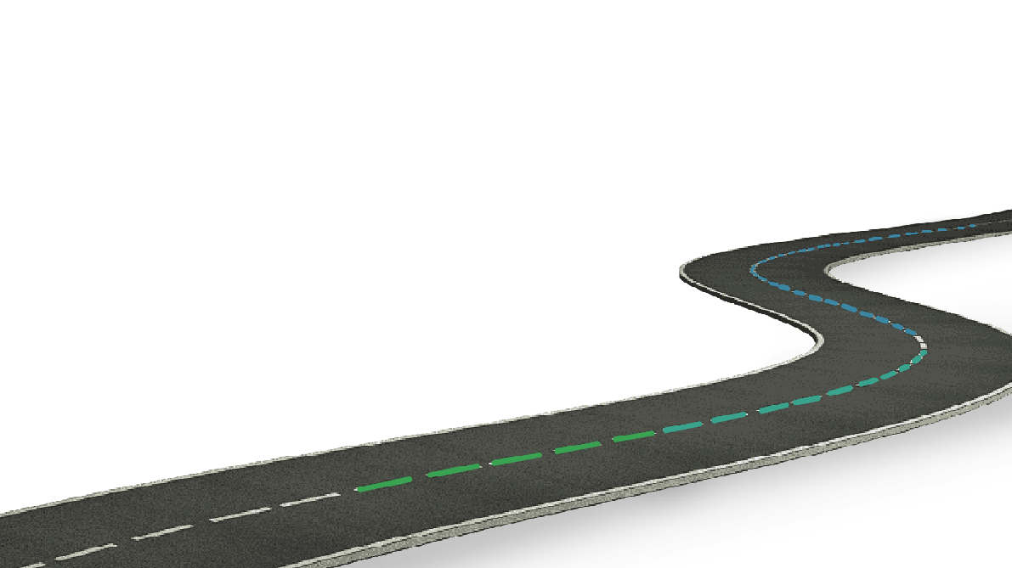



Модель Реалізації: Від Зони Ризику до Зони Розвитку (Roadmap)
Comprehensive Recovery Program: Three Pillars of Reclamation
Етап 3 (24+ міс): Контроль та масштабування.
1. Повне відновлення та стабілізація
2. Поширення на «жовті» зони.
3. Інтеграція проекту.
Long-term measures (3–10 years):
Ecosystem restoration: planting moisture-loving plants, buffer zones. Modernization of hydraulic structures. Regular monitoring of water quality and ecosystem status.
Етап 2 (6-18 міс): Рекультивація.
1. Розробка детальних планів.
2. Початок відновлювальних робіт.
3. Побудова системи моніторингу.
Етап 1 (0-6 міс): Оцінка.
1. Збір даних.
2. Аналіз та складання
карти.
3. Польове обстеження.
4. Пілотні заходи рекультивації.
Short-term measures (1–3 years):
Cleaning up debris and silt, repairing the dam. Clearing tributary channels, restoring water exchange. Creating coastal protection strips, stocking the reservoir with fish.
Social aspect:
Involvement of the community in eco-actions and care for the reservoir. Information campaign on the importance of cleanliness and sustainable use.

Slide 14
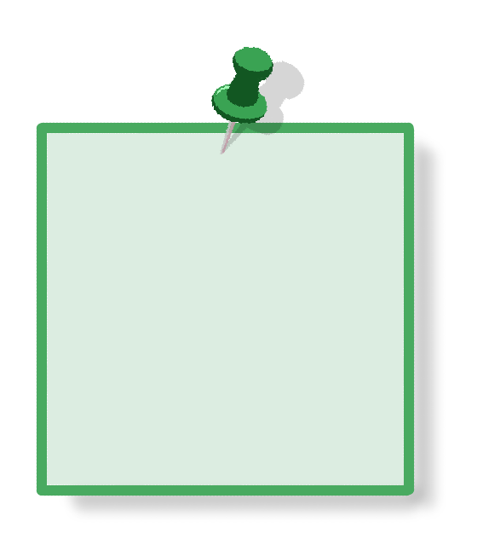

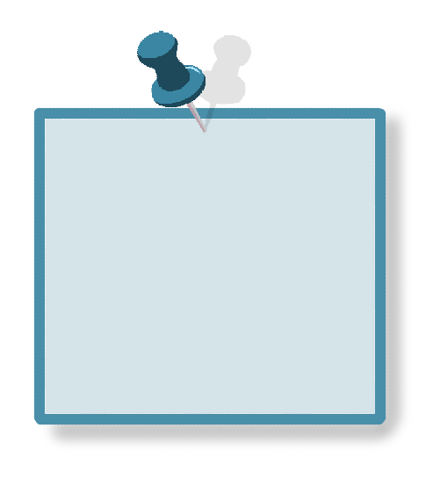
Implementation Model: From Risk Zone to Development Zone (Roadmap)
Висновки:
Stage 3 (24+ months): Control and scaling.
1. Full recovery and stabilization
2. Expansion to “yellow” zones.
3. Project integration.
Stage 2 (6-18 months): Reclamation.
1. Development of detailed plans.
2. Start of restoration work.
3. Construction of a monitoring system.
Stage 1 (0-6 months): Assessment.
1. Data collection.
2. Analysis and mapping.
3. Field survey.
4. Pilot remediation measures.

Slide 15
Conclusions:
Використана література у проєкті:
Key findings:
A comparison of Sentinel-1 and Sentinel-2 satellite data (2021–2025) was performed to determine the level of degradation of the Travyansky Reservoir.
A GIS model for assessing NDWI and NDVI changes was developed, which automatically classifies damaged areas with an accuracy of about 90%.
GIS technologies reduced the time for initial environmental assessment from several weeks to several hours, reducing the need for field surveys in hazardous areas.
Project impact:
Environmental: Approximately 118 hectares of water area and coastal areas have been restored. Soil erosion has been reduced by 20–25%.
Social: The community has been involved in eco-initiatives, and up to 30 jobs have been created in the field of recultivation and monitoring. Digital literacy of the population has been improved through training in GIS tools.
Economic: Yields of adjacent lands have been increased by 15% thanks to soil moisture stabilization and irrigation systems.
Next steps:
Validation: launch of a pilot project together with the Lipetsk united territorial community.
Scaling: Adaptation of the model for other affected regions — Sumy and Mykolaiv Oblasts.
Partnerships: Expansion of cooperation for access to updated satellite data and development of the GIS monitoring ecosystem.
The EcoUnity project proves that modern technologies are not only a tool for analysis, but also a path to the revival of nature, the development of communities, and the formation of a sustainable future for Ukraine.

Slide 16
Дякуємо за увагу
References used in the project:
Implementation Model: From Risk Zone to Development Zone (Roadmap):
1 -https://mykolaivska.land.gov.ua/рекультивація-порушених-земель/ - State Geocadastre Administration Website.
2 -https://uk.wikipedia.org/wiki/ - Wikipedia.
3 -https://insgeo.com.ua/rekultivacia-rodovysch/- Institute of Geology.
4 -https://19january2017snapshot.epa.gov/sites/production/files/2015-04/documents/a_citizens_guide_to_phytoremediation.pdf - A Citizen's Guide to Phytoremediation.
Methodology:
1 - https://uk.wikipedia.org/wiki/ - Wikipedia
2 - https://www.mao.kiev.ua/biblio/jscans/knit/2014-20/knit-2014-20-5-04-tomchenko.pdf - Use of remote sensing and ground-based observations for a comprehensive assessment of the ecosystem services of the Kyiv Reservoir based on the hierarchy analysis method
3 - https://www.mdpi.com/2072-4292/16/11/1984 - MDPI - Remote Sensing, 2024
4 - https://eprints.zu.edu.ua/41262/1/6.pdf - Eprints Zhytomyr State University, 2023
5 - https://iwaponline.com/jwcc/article/13/2/557/85451/Enhanced-index-for-water-body-delineation-and-area - IWA - Publishing, 2023

Slide 17
Thank you for your attention!

